Slide 1
NUST CLASSIFIED
BUY | SELL | CONNECT

Slide 2
TEAM
Abdul Wahab
Muhammad Rizwan Khalid
Abdullah Memon

Slide 3
Motivation
Utilise, Reuse, dispose, require
Lecture notes, assignments, novels, electronics
Problems with OLX, Quickr
Notification Platform
No current up-to-date event info source

Slide 4
Introduction
Peer-to-peer marketplace
Share equipment. Save money
Dedicated for NUST students
Free of charge, ads, logistics
Assured security, safety, counterfeit selling
Yet to kickstart in Pakistan

Slide 5
HOSTELS
Rizwan Khalid

Slide 6
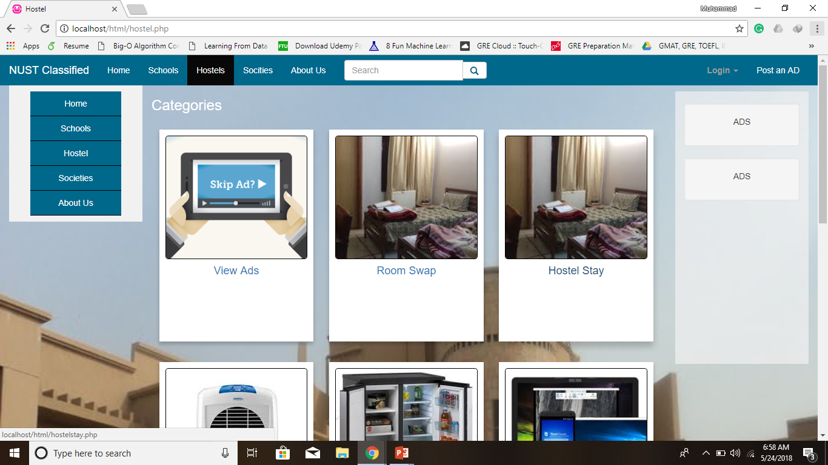
Hostel Page
Purpose
Ad categories
Dynamic Part
Ad post

Slide 7
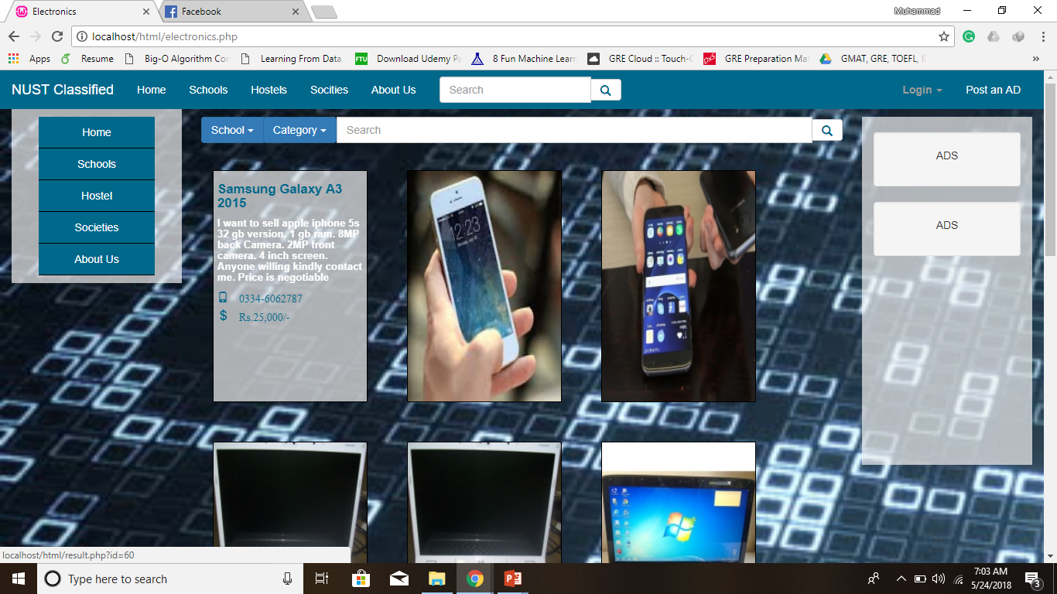
Electronics
Electronics ads
Flip card
Populating dynamically
Leads to result page

Slide 8
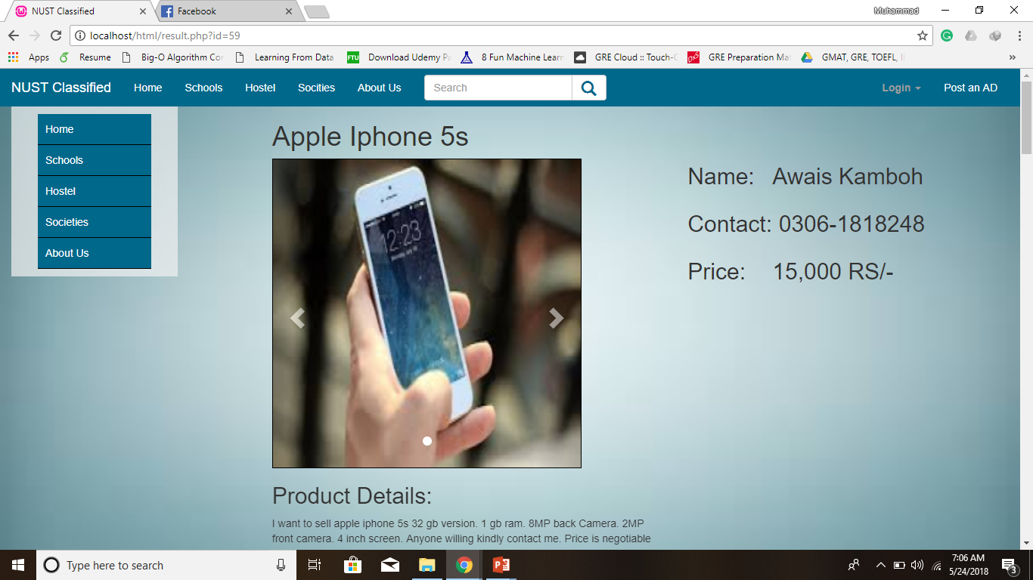
Result Page
Populating from database based on id
Addition suggested ad at botton.

Slide 9
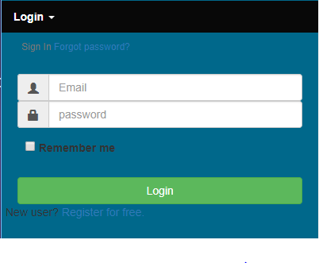
Log-in Page
Session
User Name

Slide 10
SCHOOLS

Slide 11
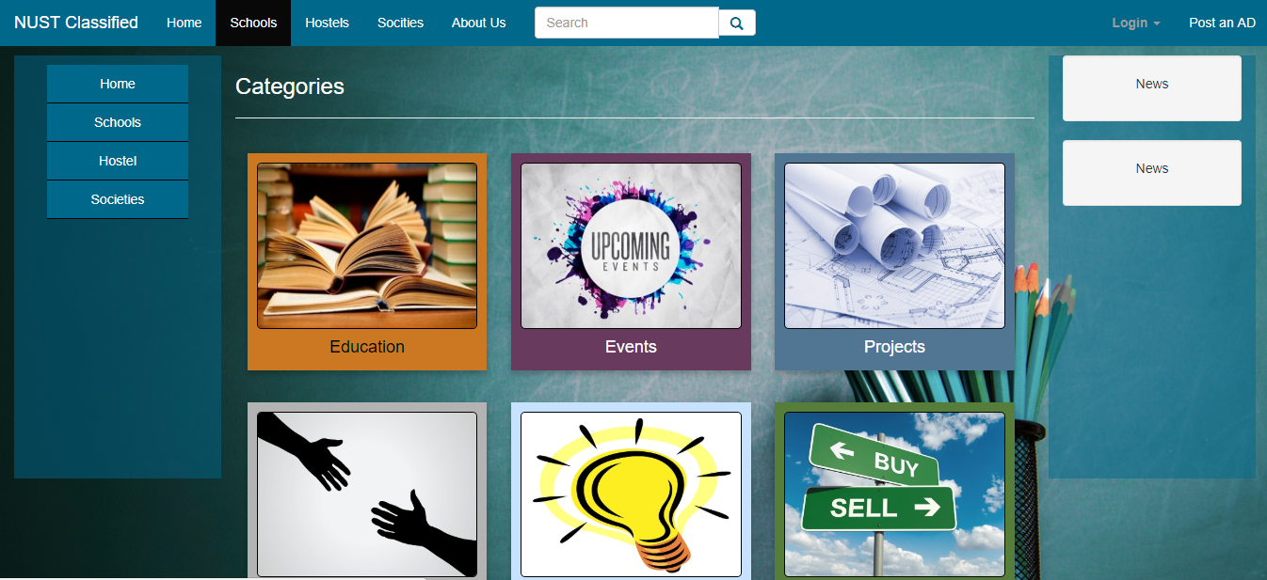
SCHOOLS
CATEGORIES
SCHOOLS
STATIC

Slide 12
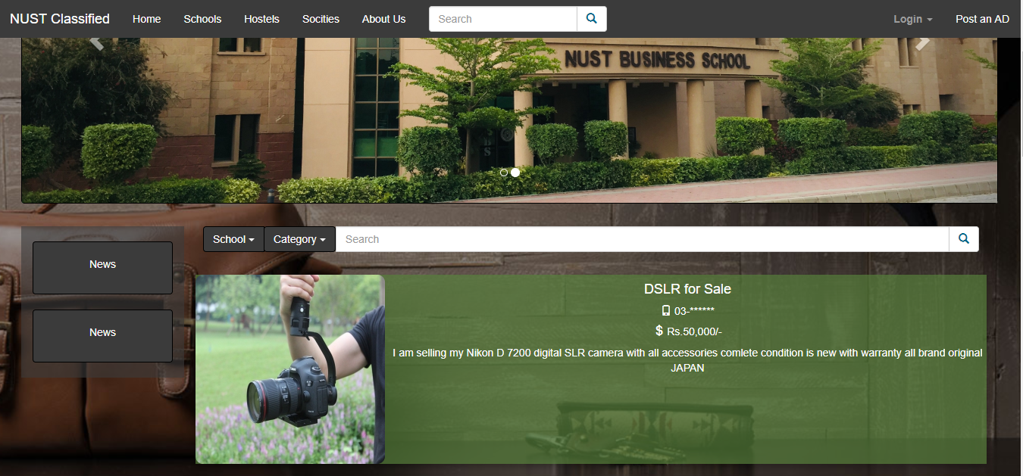
School Page
Theme
Purpose
Ads
Categories
Mapping

Slide 13
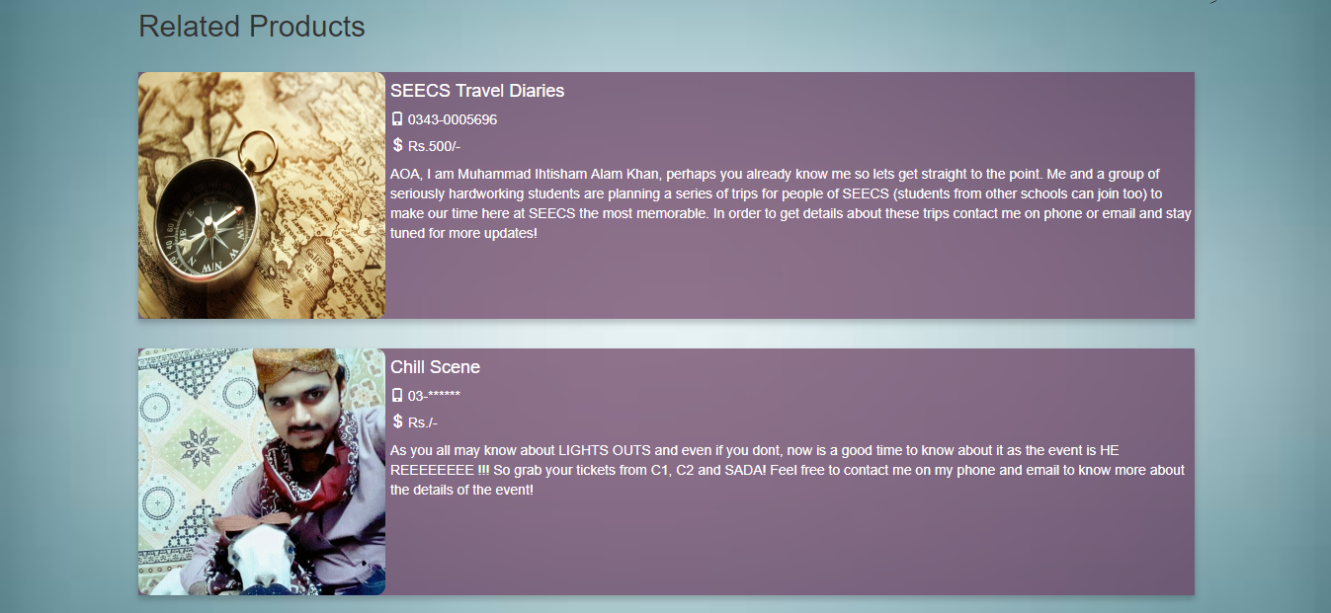
Result Page
Search Page
Suggested ads
Mapping of Ads

Slide 14
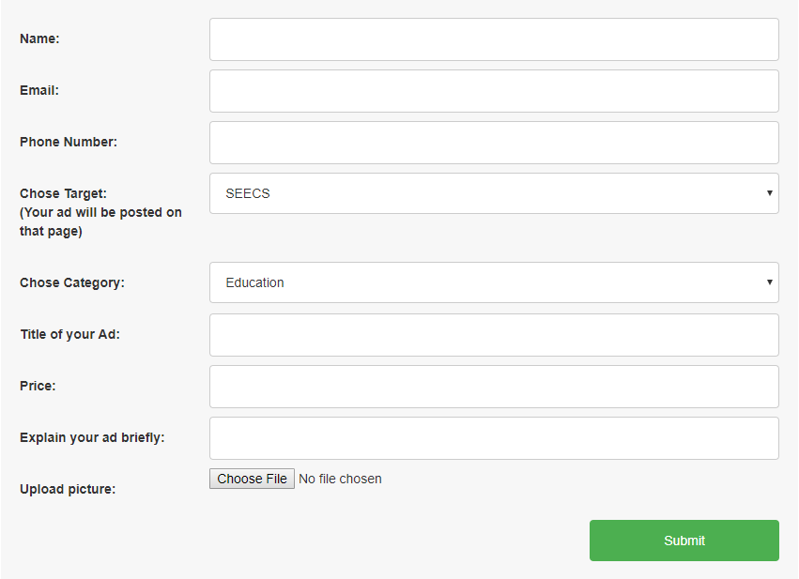
Form Page
Same Form for all
Connects with DB

Slide 15
MOTO
BUY
SELL
CONNECT

Slide 16
DEMO

